Slide 1
Comparison Life Cycle Impacts of the solid Waste Management Strategies
Waste Disposal
By.

Slide 2
Resource Conversation Challenge
Goals
Prevention of the waste and material pollution
Promotion of the recycling process within companies
Reusing of the various materials and substances
Reduction of the amount of chemicals
Increment of the various kinds of energy and the materials used in conversations
Notes:
Solid waste materials are some of the common factors afecting the growth and development of most urban areas. A lot of companies and industries are recorded to have been dospossing off their exumes to the environment which frther affects the environment a great deal.
In that case therefore, the main goals of this project is to be in a position to prevent and promote the recycling process if waste polution
It further deals with ensuring there is adequate increment of the avalilable ammount of chemicals within all the life cycles.
Lastly, the process will involve increasing the ammount of energy and absolute material conservation processes.

Slide 3
Environmental issue (Waste Disporsal)
Waste eventually rot
Bad smell on the waste disposal after some time
Generation of methane gas
Might end up producing leach ate

Slide 4
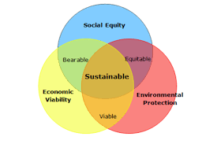
The main pillars of sustainability
Social
Desirable
Environment
Viable
Sustainable
Equitable
Economic
Notes:
\In order to effectively nderstand the basics of this project, one needs to have a clear understanding of the main pillars of sustainability towards accruing for a perfect environmebtal stability.In that case therefore, a governmet in collaboration with other companies and industries needs to be at par with one another (Ampofo, 2020).
In that case therefore, it is important to understand the main pillars which are the concept of being socially free in that you get to interact with everyone around you. There concept of disirebale and senviromental awaremess is the other pillar which deals with ensuring that understanding one anothers environment and concept of sustainability for a perfect environmental waste management.
Last but not least is the equity and economic sustainability. This means that the government should come up with policies that handles the same concept of rules and duties that will be used across all the companies and industries.

Slide 5
Why is waste Disporsal an issue?
It might lead to climate change
Can lead to air polution
Affects the ecosystem a great deal
Might affect the living and non living creatures
May lead to land fills
Notes:
Waste Disposal might be viewed on a light note by those who do not understand its impacts. However, its relative impacts is very immense and can cause chaos in a society on in environment (Ampofo, 2020).
Poor waste management can therefore be in a position to contribute towards the various factors such as the climatic changes, Eventual causation of the acid rains, possibility of air polution in the environment, and absolute landfalls among other impacts.

Slide 6
Is waste disposal a problem of a resources?
Waste is an economic loss
There is increased rates of waste being recycled or composed
This leads to environmental consumption to some point
The need to change the mode of production and consumption is also an alarm.
Notes:
Most people will tend to ask themselves the main difference existing between waste being a problem of it be a resource (Ampofo, 2020). The Europeans have a staunch belief that indeed waste dispersals are very much economical in nature and that to some point, there are some forms of increased amounts of wastes which eventually gets recycled or reused in a way or the other. Lastly, there is the need to change the mode of production and consumption is also an alarm.

Slide 7
Impacts of plastic pollution
Infiltrates the ozone layer
Plastics never decompose easily
The vest mode of handling it is through recycling
Plastics are hazardous to both air and marine creatures
Notes:
Excessive use and consumption of products packed in plastics has greatly affected the flora and the fauna together with the creatures that do depend on the water bodies a great deal. Just a slight walk across the water bodies for instance and in the market places in urban areas is just enough to speak a lot on the rapid consequences that plastics do cause to the environment. Retrieved from the National Oceanographic and the Atmospheric Administration, reports has it to the banks that the plastic debris tend to kill over 100, 000 marine creatures and mammals every year and at the same time, its disposure tends to kill a variety of birds of the air and fishes in the lakes a great deal.

Slide 8
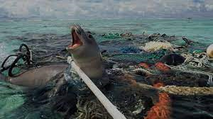
Impacts of improper waste disposal
Soil, air and water pollution
Creation of hazardous gas
Creation of greenhouse effects to the environment
Can easily harm the marine and wildlife
Notes:
The main impacts that can be collected from improper Disporsal of wastes are such as the increased rates of air, water and soil pollution. Also this contamination or rather pollution can be caused due to the trio being contaminated with very hazardous kinds of materials in the environment.
This does not only lead to or rather contribute to the increased rates of creation of the greenhouse gas effects, but rather, it further leads to very significant impacts and effects of the marine and wildlife impacts in way or the other.

Slide 9
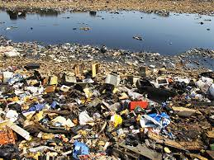
Negative impacts of waste Disporsal
Soil Contamination
Air contamination
Water contamination
Spread of diseases carrying pests
Missed kinds of recycling activities
Notes:
Waste disposal can have both negative and positive impacts on the environment. However, on the higher side, the negative effects are always more evident assured to the positives. In that case therefore, some of the negative impacts of connections that are led by waste disposals are such as sol contamination which involves exposure and disposal of waste materials on land which further lead to health effects of various kinds of living and nonliving creatures (Ampofo, 2020).
Also, there is the impact of air contamination which further leads to the health care complication of the various air creatures such as the birds and other flying creatures. Last but not least, various kinds of illnesses or airborne and waterborne diseases can easily be spread in a way or the other which can further lead to spread of diseases maybe by pests among others.

Slide 10
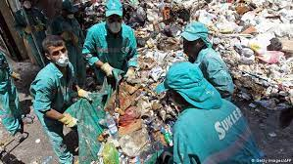
Waste disposal problems
Production of too much waste
Most of the wastes emitted is very toxic
Increased problem of landfills
Regulations are always based on vested interests
Notes:
There are lots of problems that are caused by the waste disposal to the environments a great deal. Some of the complications or problems are such as the kinds of emissions that are always produced by these industries and companies are very toxic and harmful to the environment and the living and non ,living things in it.
Also, the waste disposals are in position to identify that most of the regulations that are always given out are based on those people who are on certain social classes and that they are vested on various concepts and accountabilities (Sangkham, 2020).
Last but not least, the companies are not in a position to identify various kinds of regulations and the ammount of waste that they are supposed to emit to the environment in a way or the other. Hence leading to a very intense and detrimental challenge on equity and acceptance between the governments and the companies or rather industries.

Slide 11
Solutions to waste dispersals
Recycling
Landfill method
Composition of food scraps and other organic wastes
Collect, Transport and store wastes safely
Notes:
There are lots of solutions that can be used to handle the problems of waste disposal in the environment and some of the best solutions are such as the Recycling process. This basically involves the concept of converting the waste materials into other important and used materials in way or the other.
Secondly, apply the landfill process which is very much likely to cause both air and land or soil polution in spite of all the precautionary measures that will have been take in to place (Sangkham, 2020).
Thirdly is the ability to compose the various food scraps and other kinds of organic wastes Hence leading to the quest to making sure that all the waste materials are always reused by all means.
Lastly, the persons or the bodies responsible should always be very vigilant on making sure that the waste products are collectively placed in an area or a bit, they get transported to various designated areas and finally making sure that all the wastes are stored with absolute safety (Sangkham, 2020).

Slide 12
Negative impacts of plastic on the environment
It kills both living and non living animas
It prevent agricultural development in the areas affected
It does not easily decompose
It changes the portfolio of the society and the community at large
Notes:
Plastic has been world widely realized to be so much problematic in nature! Its continuous use in almost every aspect in the society and in the life of human beings has led to great impacts such as creation of very homogenous piles of ultimate indecomposable kind of waste matter. This has further come up with hell of debris on both the land surface and also on the water surface since it is spilled all over these surfaces.

Slide 13
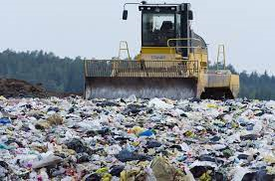
How to prevent waste disposal
Apply the use of reusable bottles and cups for the drinks and beverages
Use of the reusable grocery bags and not polythene
Always purchase what you can effectively consume
Always have a compost site where you will compose the waste products.
Notes:
Apply the use of reusable bottles and cups for the drinks and beverages. Use of the reusable grocery bags and not polythene. Always purchase what you can effectively consume (Sangkham, 2020). Always have a compost site where you will compose the waste products.

Slide 14
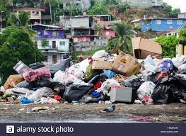
Importance of proper waste Disporsal
Gives support to recycling
Saves precious materials
Renewal of wastes for other purposes
Prevents wastes from going into landfill
Limits the manufacture of new kinds of materials.
Notes:
The process of having a proper waste Disporsal methods that are always available are such as being able to give ultimate support to the main concepts of the recycling and also be in a position to save the precious kinds of materials (Ahmad, et al. 2020).
Waste disposal is considered very important as it is in a position to, Gives support to recycling, Saves precious materials, Renewal of wastes for other purposes, Prevents wastes from going into landfill and Limits the manufacture of new kinds of materials.

Slide 15
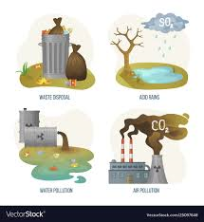
Ho waste disposal affects the community
Leads to damage to the environment
Air pollution
Water pollution
Soil Polution
Excessive exposure to toxic chemicals
Notes:
Most people will tend to ask themselves the main difference existing between waste being a problem of it be a resource (Ahmad, et al. 2020). The Europeans have a staunch belief that indeed waste disposals are very much economical in nature and that to some point, there are some forms of increased amounts of wastes which eventually gets recycled or reused in a way or the other. Lastly, there is the need to change the mode of production and consumption is also an alarm.

Slide 16
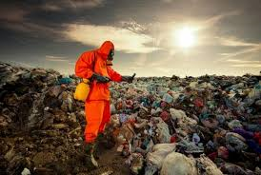
Steps taken by the government to rectify waste disposal
Source Reduction
Segregation
Recycling
Concentration
Notes:
The governments and the World Health organizations are playing very important roles towards ensuring that the waste disposals are effectively dealt with. Some of these steps are such as being in a position to reduce the source in that the ammount of production will have o be advanced and made to be on a higher level than the other.
Secondly, the government should be responsible to handle the concept of segregation and recycling which involves reusing of the waste materials and transforming them into other additional important materials in the society (Ahmad, et al. 2020).
Lastly, there is need to consider concentration in that there is need to consider the various kinds of products that gets legalized to be produced and also the industries and the companies producing various kinds of emissions needs to be placed at a strategic area to assist in environmental pollution manages.

Slide 17
References
.
Ahmad, S., Iqbal, N., Jamil, F., & Kim, D. (2020). Optimal policy-making for municipal waste management based on predictive model optimization. IEEE Access, 8, 218458-218469.
Sangkham, S. (2020). Face mask and medical waste disposal during the novel COVID-19 pandemic in Asia. Case Studies in Chemical and Environmental Engineering, 2, 100052.
Ampofo, J. A. (2020). Waste disposal management practices in selected senior high schools within the Wa Municipality of Ghana. International Journal of Management & Entrepreneurship Research, 2(4), 273-290.
.

